Slide 1
COMPUTER STORE INFORMATION MANAGEMENT SYSTEM
Made by: Group 15

Slide 2
Group 15:
Mai Xuan Hieu
Do Hoang Phuong
Hoang Huu Huy
Pham Hoang Viet
Ly Anh Kiet

Slide 3
COMPUTER STORE INFORMATION MANAGEMENT SYSTEM
Introduction
Structure
Demo
Conclusion

Slide 4
INTRODUCTION
The information manage system is a system which collects, processes, stores and distributes information:
Staff
Customer
Product
It is a system that required people and computers to process or interpret information.
Project goals :
Decision-making
Coordination
Control
Analysis
Visualization of information

Slide 5
STRUCTURE
Modules
Database diagram

Slide 6
Modules
Tkinter.messagebox: Access to standard TK dialog boxes.
Tkinter.ttk: Provide access to the Tk themed widget set.
MySQL connector: database driver to process data in MySQL from python.
Os: Provide functions for interacting with the operating system.

Slide 7
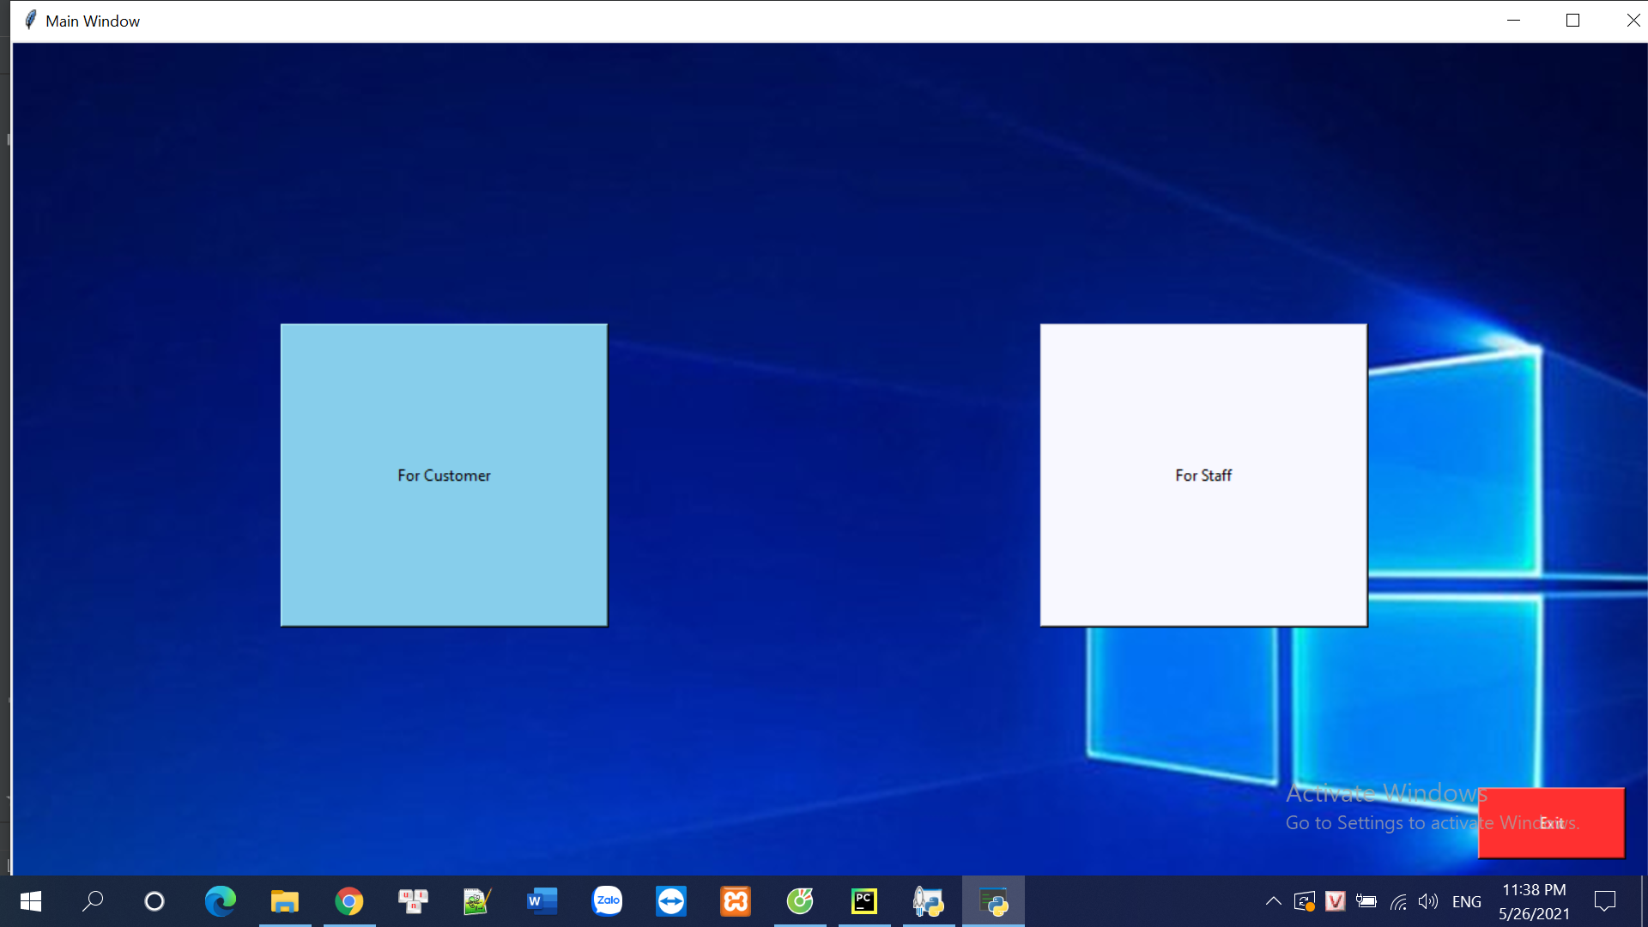
Modules
Main_windown: to choose the user’s role.

Slide 8
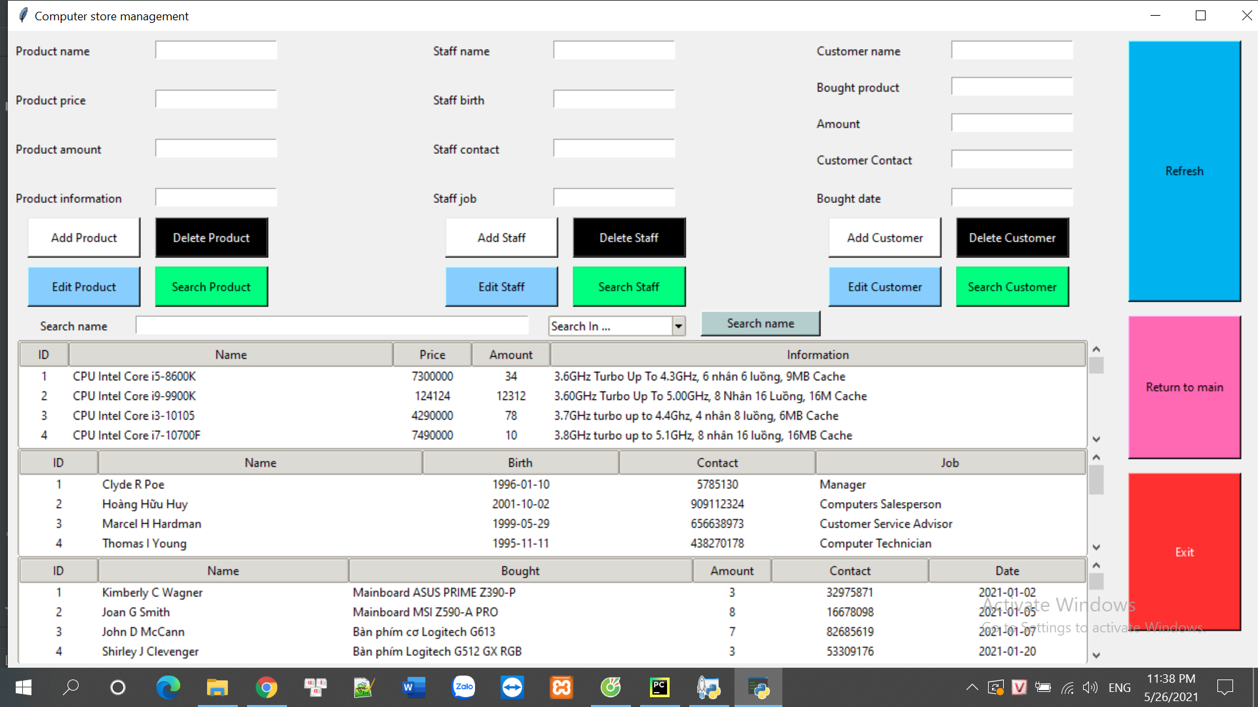
Modules
Computer_store_management: for staff to manage information of staffs, customers and products.

Slide 9
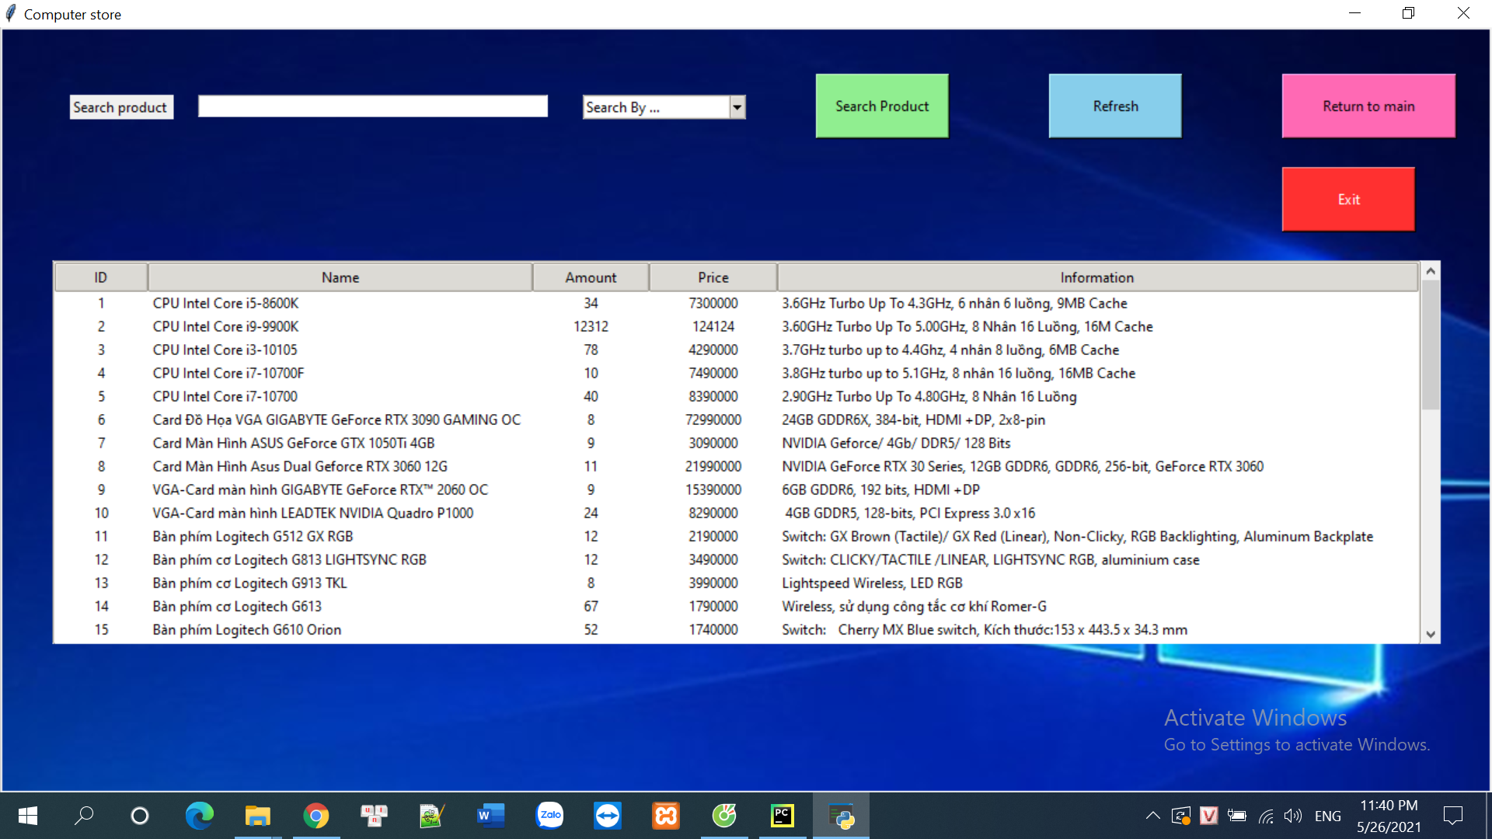
Modules
Computer_store: for customer to collect information of products.

Slide 10
Database diagram
ID
Contact
Customer
Name
Date
Bought
Amount

Slide 11
Database diagram
Information
ID
Price
Product
Name
Amount

Slide 12
Database diagram
Date of birth
ID
Contact
Staff
Name
Job

Slide 13
Database diagram
Price
Amount
Information
Name
ID
Bought
Contact
Name
Product
Search/buy
Customer
Date
ID
Amount
Manage
Staff
Sell
Name
ID
DOB
Job
Contact

Slide 14
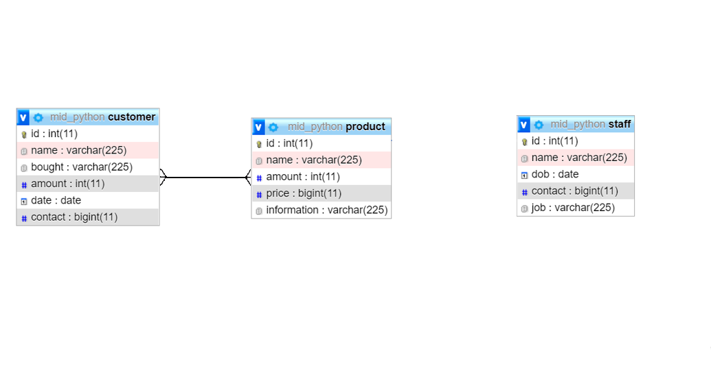
Database diagram:

Slide 15
DEMO

Slide 16
CONCLUSION
THE SYSTEM:
COMPUTER STORE INFORMATION MANAGEMENT SYSTEM
Part 1: For store
Collect, store and manage the information of staff, product, customer and order
Part 2: For customer
Find out about product

Slide 17
CONCLUSION
DRAWBACKS:
Security concern.
User’s front still lacking.
Method is suitable for larger or more complex design.

Slide 18

Thanks!
Any questions,
please feel free to ask!

